Slide 1
Object-Oriented Programming
Exceptions
Weiwei Xu

Slide 2
Run-time Error
The basic philosophy of C++ is that "badly formed code will not be run."
There's always something happens in run-time.
It is very important to deal with all possible situation in the future running.

Slide 3
read a file
open the file;
determine its size;
allocate that much memory;
read the file into memory;
close the file;

Slide 4
errorCodeType readFile {
initialize errorCode = 0;
open the file;
if ( theFilesOpen ) {
determine its size;
if ( gotTheFileLength ) {
allocate that much memory;
if ( gotEnoughMemory ) {
read the file into memory;
if ( readFailed ) {
errorCode = -1;
}
} else {
errorCode = -2;
}
} else {
errorCode = -3;
}
close the file;
if ( theFILEDidntClose && errorCode == 0 ) {
errorCode = -4;
} } else {
errorCode = -5;
}
return errorCode;
}

Slide 5
Working w/ exception
try {
open the file;
determine its size;
allocate that much memory;
read the file into memory;
close the file;
} catch ( fileOpenFailed ) {
doSomething;
} catch ( sizeDeterminationFailed ) {
doSomething;
} catch ( memoryAllocationFailed ) {
doSomething;
} catch ( readFailed ) {
doSomething;
} catch ( fileCloseFailed ) {
doSomething;
}

Slide 6
exception
I take exception to that：
At the point where the problem occurs, you might not know what to do with it, but you do know that you can’t just continue on merrily; you must stop, and somebody, somewhere, must figure out what to do.

Slide 7
Why exception?
The significant benefit of exceptions is that they clean up error handling code.
It separates the code that describes what you want to do from the code that is executed.

Slide 8
Example: Vector
template <class T> class Vector {
private:
T* m_elements;
int m_size;
public:
Vector (int size = 0) : m_size(size) ...
~Vector () { delete [] m_elements; }
void length(int);
int length() { return m_size; }
T& operator[](int);
};

Slide 9
Problem

Slide 10
Problem
template <class T>
T& Vector<T>::operator[](int indx) {

Slide 11
Problem
template <class T>
T& Vector<T>::operator[](int indx) {

Slide 12
Problem
template <class T>
T& Vector<T>::operator[](int indx) {
What should the [] operator do if the index is
not valid?

Slide 13
Problem
template <class T>
T& Vector<T>::operator[](int indx) {
What should the [] operator do if the index is
not valid?

Slide 14
Problem
template <class T>
T& Vector<T>::operator[](int indx) {
What should the [] operator do if the index is
not valid?
1.) Return random memory object
return m_elements[indx];

Slide 15
More choices
2.) Return a special error value
if (indx < 0 || indx >= m_size) {
T* error_marker =
new T("some magic value");
return *error_marker;
}
return m_elements[indx];
But this throws the baby out with the bath!
x = v[2]+v[4]; // not safe code!

Slide 16
More choices ...

Slide 17
More choices ...
3.) Just die!
if (indx < 0 || indx >= m_size){
exit(22);
}
return m_elements[indx];
4.) Die gracefully (with autopsy!) assert(indx >= 0 && indx < m_size); return m_elements[indx];

Slide 18
When to use exceptions
Many times, you don't know what should be done
If you do anything you’ll be wrong
Solution: turf the problem
Make your caller (or its caller ...) responsible

Slide 19
How to raise an exception
template <class T>
T& Vector<T>::operator[](int indx) {
if (indx < 0 || indx >= m_size) {
// throw is a keyword
// exception is raised at this point
throw <<something>>;
}
return m_elements[indx];
}

Slide 20
What do you throw?
// What do you have? Data!
// Define a class to represent the error
class VectorIndexError {
public:
VectorIndexError(int v) : m_badValue(v) { }
~VectorIndexError() { }
void diagnostic() {
cerr << "index " << m_ badValue
<< "out of range!"; }
private:
int m_badValue;
};

Slide 21
How to raise an exception
template <class T>
T& Vector<T>::operator[](int indx){
if (indx < 0 || indx >= m_size) {
// VectorIndexError e(indx);
// throw e;
throw VectorIndexError(indx);
}
return m_elements[indx];
}

Slide 22
What about your caller?
Case 1) Doesn’t care
–Code never even suspects a problem
int func() {
Vector<int> v(12);
v[3] = 5;
int i = v[42]; // out of range
// control never gets here!
return i * 5;
}

Slide 23
What about your caller?
Case 2) Cares deeply
void outer() {
try {
func(); func2();
} catch (VectorIndexError& e) {
e.diagnostic();
// This exception does not propagate
}
cout << "Control is here after exception";
}

Slide 24
What about your caller?
Case 3) Mildly interested
void
outer2() {
String
try {
err("exception
caught");
func();
} catch
cout
(VectorIndexError) {
<< err;
throw;
// propagate the
exception
}
}

Slide 25
What about your caller?
Case 4) Doesn’t care about the particulars
void outer3() {
try {
outer2();
} catch (...) {
// ... catches ALL exceptions!
cout << "The exception stops here!";
}
}

Slide 26
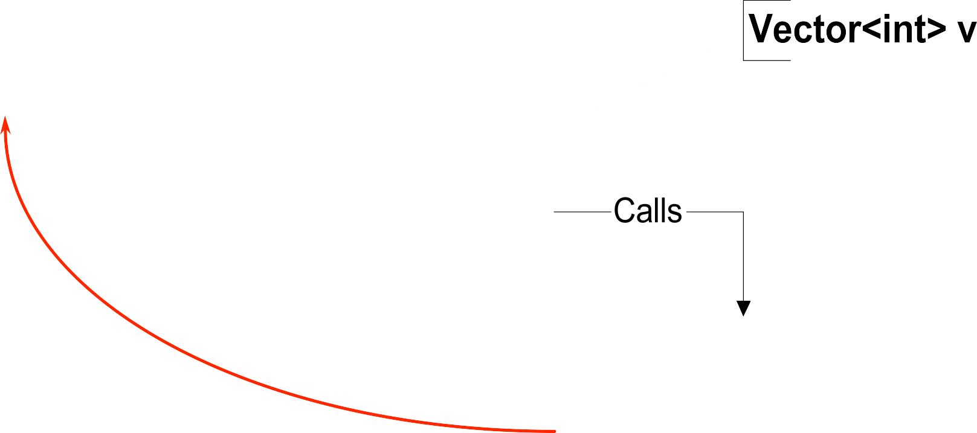

What happened?

Slide 27
Review
Throw statement raises the exception
– Control propagates back to first handler for that exception
– Propagation follows the call chain
– Objects on stack are properly destroyed
• throw exp;
–throws value for matching
• throw;
– reraises the exception being handled
–valid only within a handler

Slide 28
Try blocks
Try block
try { ... }
catch ...
catch ...
Establishes any number of handlers
Not needed if you don’t use any handlers
Shows where you expect to handle exceptions
Costs cycles

Slide 29
Exception handlers
Select exception by type
Can re-raise exceptions
Two forms
catch (SomeType v) { // handler code
}
catch (...) { // handler code
}
Take a single argument (like a formal parameter)

Slide 30
Selecting a handler
Can have any number of handlers
Handlers are checked in order of appearance
  Check for exact match
  Apply base class conversions
Reference and pointer types, only
  Ellipses (...) match all
Inheritance can be used to structure exceptions

Slide 31
Example: using inheritance
Hierarchy of exception types
class MathErr {
...
virtual void diagnostic();
};
class
OverflowErr
: public
MathErr
{ ... }
class
UnderflowErr
: public
MathErr
{ ... }
class
ZeroDivideErr
: public
MathErr
{ ... }

Slide 32
Using handlers
try {
// code to exercise math options
throw UnderFlowErr();
} catch (ZeroDivideErr& e) {
// handle zero divide case
} catch (MathErr& e) {
// handle other math errors
} catch (...) {
// any other exceptions
}

Slide 33
Exceptions and new
new does NOT returned 0 on failure
new raises a bad_alloc() exception
void func() {
try {
while(1) {
char *p = new char[10000];
}
} catch (bad_alloc& e) {
}
}

Slide 34







Standard library exceptions
(Synopsis)

Slide 35
Exception specifications
Declare which exceptions function might raise
Part of function prototypes
void abc(int a) : throw(MathErr) {
...
}
Not checked at compile time
At run time,
–if an exception not in the list propagates out, the unexpected exception is raised

Slide 36
Examples
Printer::print(Document&) :
throw(PrinterOffLine, BadDocument)
{ ...
PrintManager::print(Document&) :
throw (BadDocument) { ...
// raises or doesn’t handle BadDocument
void goodguy() : throw () {
// handles all exceptions
void average() { } // no spec, no checking,

Slide 37
Design considerations
Exceptions should indicate errors
Here is an inappropriate use:
try {
for (;;) {
p = list.next()
...
} catch (List::end_of_list) {
// handle end of list here
}

Slide 38
Design considerations ...
Don’t use exceptions in place of good design
void func() {
File f;
if (f.open("somefile")) {
try {
// work with f
} catch (...) {
f.close()
}
}
}
This is a good place to use the destructor

Slide 39
void func() {
File f("some file");
// assume destructor closes f
// will still be closed if exception is raised!
if (f.ok()) {
}
}

Slide 41
Summary

Slide 42
Summary
Error recovery is a hard design problem

Slide 43
Summary
Error recovery is a hard design problem
All subsystems need help from their clients to handle exceptional cases

Slide 44
Summary
Error recovery is a hard design problem
All subsystems need help from their clients to handle exceptional cases
Exceptions provide the mechanism
–Propagated dynamically
–Objects on stack destroyed properly
–Act to terminate the problematic function
Another big use:
–Constructors that can’t complete their work

Slide 45
More exceptions
Exceptions and constructors
Exceptions and destructors
Design and usage with exceptions
Handlers

Slide 46
Failure in constructors:
No return value is possible
Use an “uninitialized flag”
Defer work to an Init() function
Better: Throw an exception

Slide 47

Failure in constructors...
If you constructor can’t complete, throw an exception.
Dtors for objects whose ctor didn’t complete won’t be called.
Clean up allocated resources before throwing.

Slide 48
Two stages construction
Do normal work in ctor
–Initialize all member objects
–Initialize all primitive members
–Initialize all pointers to 0
–NEVER request any resource
  File
  Network connection
  Memory
Do addition initialization work in Init()

Slide 49
Exceptions and destructors
Destructors are called when:
Normal call: object exits from scope
During exceptions: stack unwinding invokes dtors on objects as scope is exited.
What happens if an exception is thrown in a destructor?

Slide 50
Exceptions and destructors...
Throwing an exception in a destructor that is itself being called as the result of an exception will invoke std::terminate().
Allowing exceptions to escape from destructors should be avoided.

Slide 51
Programming with exceptions
Prefer catching exceptions by reference
Throwing/catching by value involves slicing:
struct X {};
struct Y : public X {};
try {
throw Y();
} catch(X x) {
// was it X or Y?
}

Slide 52
Programming with exceptions...
Throwing/catching by pointer introduces coupling between normal and handler code:
try {
throw new Y();
} catch(Y* p) {
// whoops, forgot to delete..
}

Slide 53
Catch exceptions by reference:
struct B {
virtual void print() { /* … */ }
};
struct D : public B { /* … */ };
try {
throw D(“D error”);
}
catch(B& b) {
b.print() // print D’s error.
}

Slide 54
Exception Hierarchies
Use inheritance hierarchies for exceptions Problem:
try {
… throw SomethingElse();
}
catch(This& t) { /* … */ }
catch(That& t) { /* … */ }
catch(Other& t) { /* … */ }

Slide 55
Exception Hierarchies
class B {};
class D1 : public B {};
class D2 : public B {};
...
try {
… throw D1();
}
catch(D2& t) { /* catch specific class here */ }
catch(B& t) { /* anything else here. */ }

Slide 56
Exceptions wrapup

Slide 57
Exceptions wrapup
Develop an error-handling strategy early in design.

Slide 58
Exceptions wrapup
Develop an error-handling strategy early in design.
Avoid over-use of try/catch blocks. Use objects to acquire/release resources.

Slide 59
Exceptions wrapup
Develop an error-handling strategy early in design.
Avoid over-use of try/catch blocks. Use objects to acquire/release resources.
Don’t use exceptions where local control structures will suffice

Slide 60
Exceptions wrapup
Develop an error-handling strategy early in design.
Avoid over-use of try/catch blocks. Use objects to acquire/release resources.
Don’t use exceptions where local control structures will suffice
Not every function can handle every error.

Slide 61
Exceptions wrapup...

Slide 62
Exceptions wrapup...
Use exception-specifications for major interfaces.

Slide 63
Exceptions wrapup...
Use exception-specifications for major interfaces.
Library code should not decide to terminate a program. Throw exceptions and let caller decide.

Slide 64
Uncaught exceptions
If an exception is thrown by not caught
std::terminate() will be called.
terminate() can also be intercepted.
void my_terminate()
…
{ /* … */ }
set_terminate(my_terminate);

Slide 65
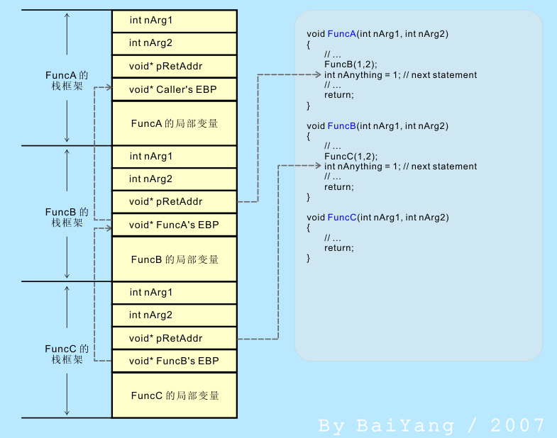
Exception Inside
C++ exception handling mechanism is based on stack unwinding mechanism.
FuncA
Call
FuncB
Call
FuncC
Normal stack frame
without exception code

Slide 66
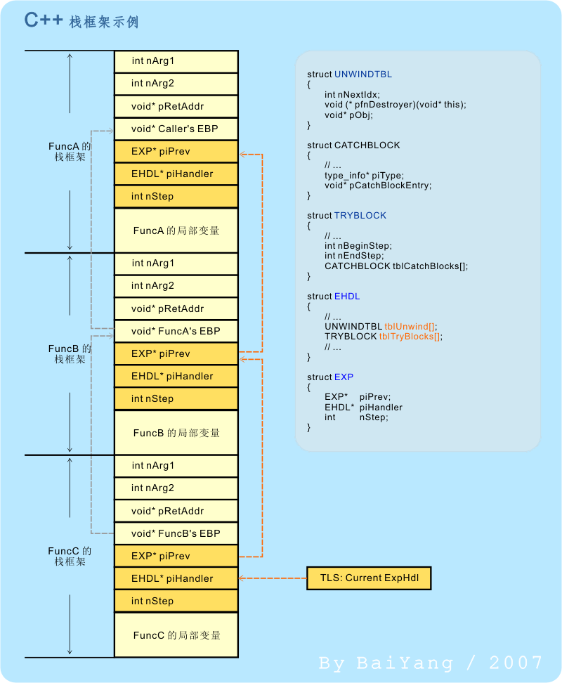
Normal stack frame
without exception code
stack frame
with exception code

Slide 67
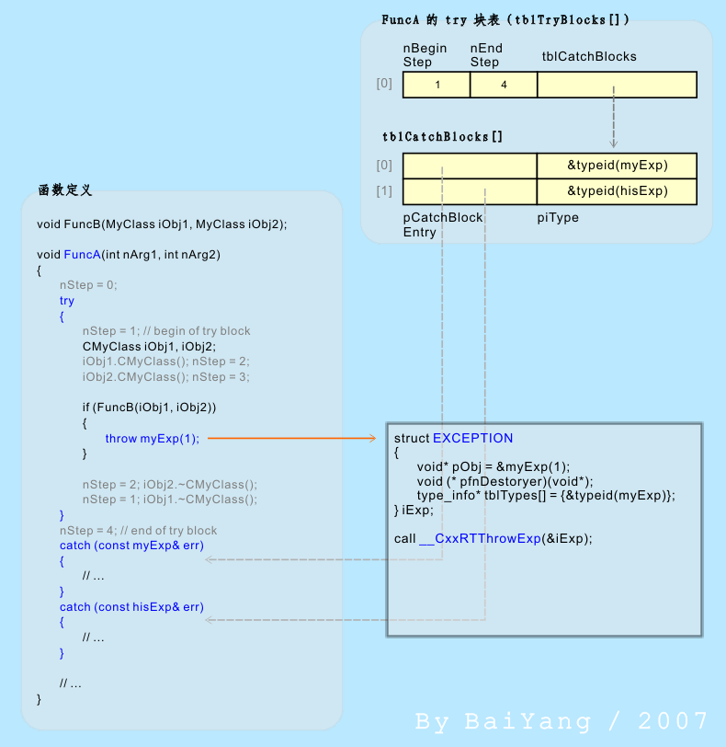
Exception Inside
FuncA
Call
FuncB
How C++ handle throw

Slide 68
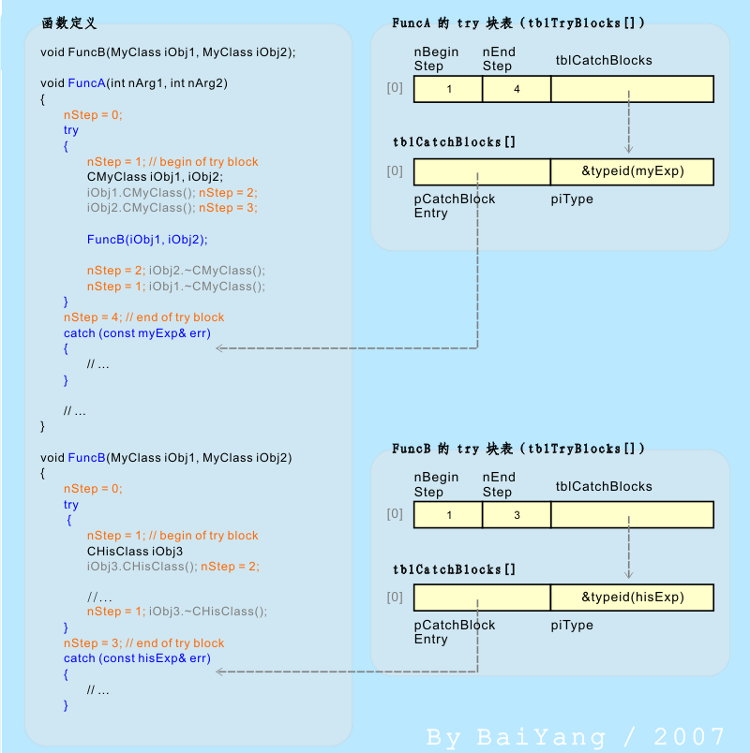
Exception Inside
How does C++
determine which block to call
http://www.baiy.cn/doc/cpp/inside_exception.htm

